Slide 1
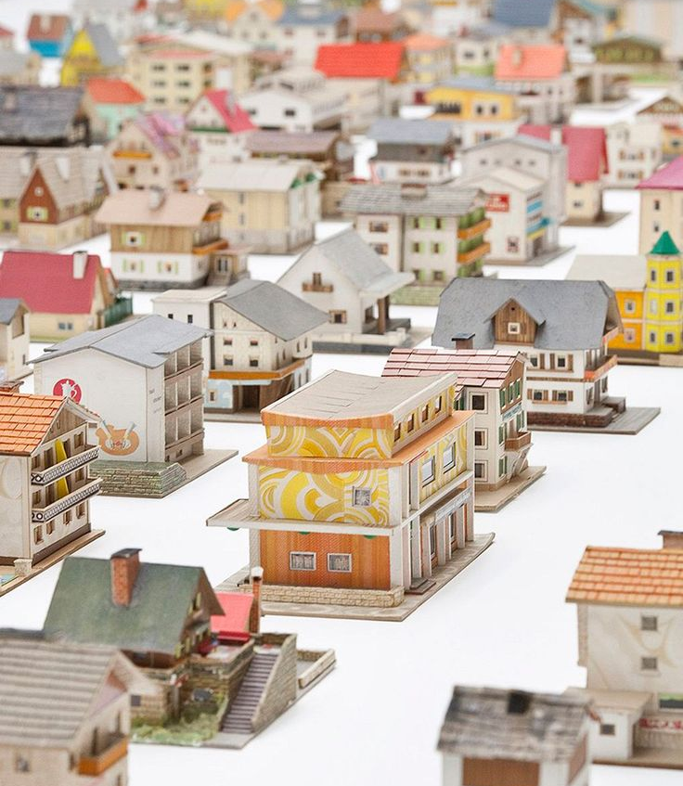
Housing is a Nightmare
From Group 4 Class 2

Slide 2

95%
Of students live by renting households.

Slide 3

2 OUT OF 5
People have some sort of problem with their roommates

Slide 4



Who are we ?
A group of young students studying ICT with the task to give a solution

Slide 5

Group Work
Divide and conquer
_______________
Trust the process

Slide 6
Features
Log in / Register
Admin / Tenant Windows
Cleaning schedule
Grocery list
Garbage removal
Complains portal
Rules
Announcements
Rent tracker
Admin tenants control
Save new information and tenants

Slide 7





Things that WILL be improved:
Organizing meetings
Use of GIT
Attention to others work
Better user experience
Work division

Slide 8





Things that are going well:
Team communication
Team spirit
Code
Implementation
Functionality management
Problem solving

Slide 9
What will the demo contain:
User register
Admin menu
Different tasks and features
Explanation about the app

Slide 10


Slide 11


